Slide 1
Data Management 2: data curation and data management
Team Members: Pooja Patil
Apurva Vasaikar
Sheethal Raghavendra
Ashwith Anand Poojary

Slide 2
Project Overview:
Objective: To build an automated pipeline for managing, integrating, and analyzing Air quality and weather data.
Tools Used:
Data Storage and Processing: Google Cloud Storage, BigQuery
Data Transformation: dbt
Distributed Processing: DataProc
Workflow Automation: Cloud Composer
Data Sources:
Beijing Air Pollution Data: Static data with a 6 months interval http://api.waqi.info/feed/%7Bcity%7D/?token=%7Bapi_token%7D
WeatherAPI.com Data: Weather API with a 10-minute interval https://www.weatherapi.com/

Slide 3
Data Ingestion and Storage:
Dataset: Static data containing 26 rows and 165 columns.
Google Cloud Storage: Used for initial data upload and storage access.
BigQuery Table: A table was created to mirror the CSV structure, supporting Star Schema development with dbt.

Slide 4
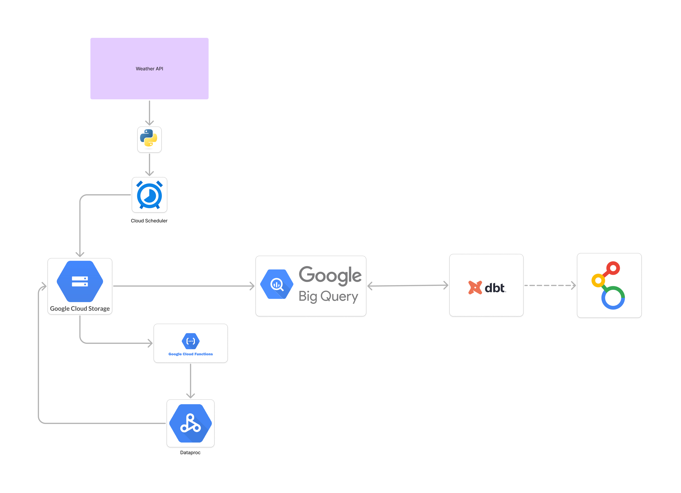
Air Pollution Architecture:

Slide 5
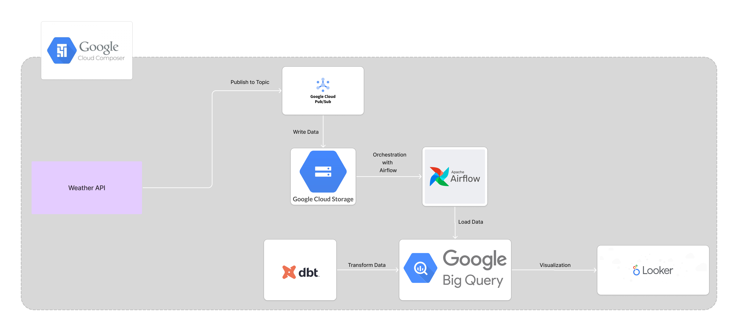
Weather API Architecture:

Slide 6
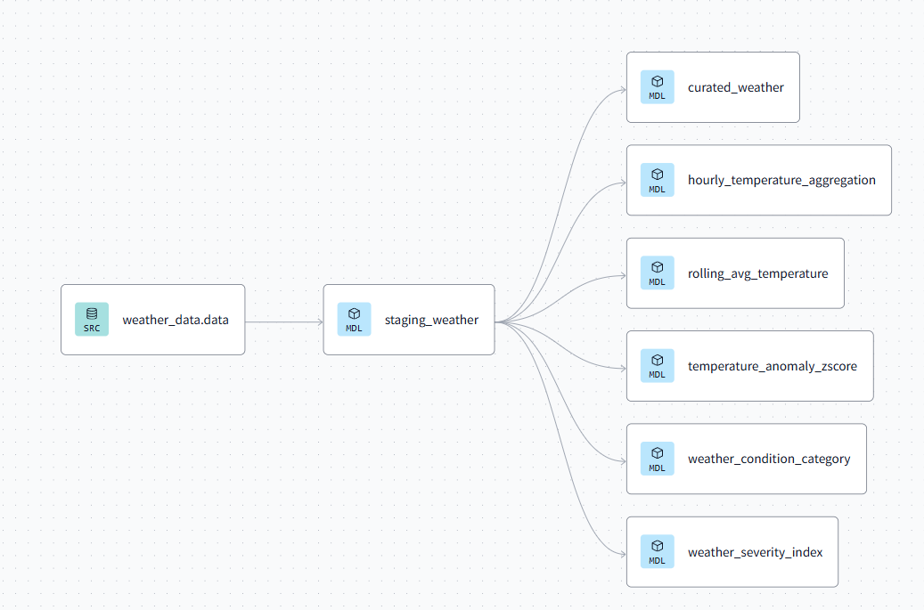
Lineage Graph:

Slide 7
Data Transformation with Apache Spark on DataProc:
Weather Severity Index
Use Case: Identify regions with extreme or dangerous weather conditions.
Rolling Averages for Trends
Use Case: Monitor real-time trends and fluctuations.
Time-Based Aggregations
Use Case: Summarize real-time data for dashboarding.
Weather Condition Categorization
Use Case: Classify weather into easy-to-understand categories.
Real-Time Z-Score for Anomaly Detection
Use Case: Identify extreme outliers in real-time.

Slide 8
Conclusion:
Comprehensive Pipeline Test: Following a successful simulation, the entire pipeline was run with live air pollution and weather data from WeatherAPI.
Continuous Real-Time Updates: Configured Airflow to automatically pull, process, and load data continuously.
Outcome: Verified the pipeline’s reliability and scalability for managing real-time air quality and weather data with automated updates in BigQuery.

Slide 9

Thank you

